Slide 1
Analysis of
Software Architectures
Software Architecture
Lecture 13

Slide 2
What Is Architectural Analysis?
Architectural analysis is the activity of discovering important system properties using the system’s architectural models.
  Early, useful answers about relevant architectural aspects
  Available prior to system’s construction
Important to know
  which questions to ask
  why to ask them
  how to ask them
  how to ensure that they can be answered

Slide 3
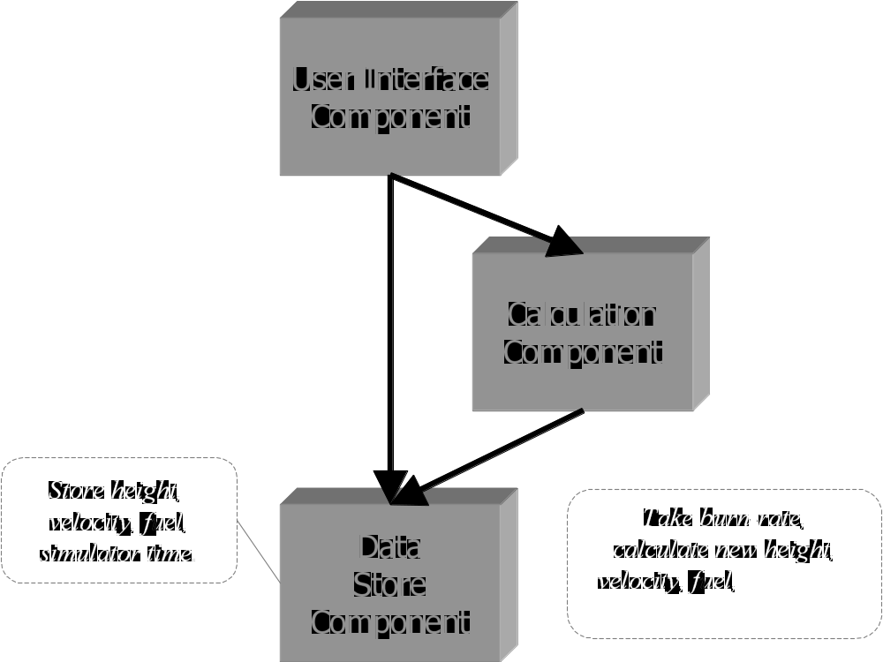
Informal Architectural Models and Analysis
Helps architects get clarification from system customers
Helps managers ensure project scope
Not as useful to developers
Software Architecture: Foundations, Theory, and Practice; Richard N. Taylor, Nenad Medvidovic, and Eric M. Dashofy; © 2008 John Wiley & Sons, Inc. Reprinted with permission.

Slide 4
Formal Architectural Models and Analysis
Component UserInterface
Port getValues
Port calculate
Computation
Connector Call
Role Caller =
Role Callee =
Glue =
Configuration LunarLander
Instances
DS : DataStore
C : Calculation
UI : UserInterface
CtoUIgetValues, CtoUIstoreValues, UItoC, UItoDS : Call
Attachments
C.getValues as CtoUIgetValues.Caller
DS.getValues as CtoUIgetValues.Callee
C.storeValues as CtoUIstoreValues.Caller
DS.storeValues as CtoUIstoreValues.Callee
UI.calculate as UItoC.Caller
C.calulate as UItoC.Callee
UI.getValues as UItoDS.Caller
DS.getValues as UItoDS.Callee
End LunarLander.
Helps architects determine component composability
Helps developers with implementation-level decisions
Helps with locating and selecting appropriate OTS components
Helps with automated code generation
Not as useful for discussions with non-technical stakeholders
Software Architecture: Foundations, Theory, and Practice; Richard N. Taylor, Nenad Medvidovic, and Eric M. Dashofy; © 2008 John Wiley & Sons, Inc. Reprinted with permission.

Slide 5
Concerns Relevant to Architectural Analysis
Goals of analysis
Scope of analysis
Primary architectural concern being analyzed
Level of formality of architectural models
Type of analysis
Level of automation
System stakeholders interested in analysis

Slide 6
Architectural Analysis Goals
The four “C”s
  Completeness
  Consistency
  Compatibility
  Correctness

Slide 7
Architectural Analysis Goals – Completeness
Completeness is both an external and an internal goal
It is external with respect to system requirements
  Challenged by the complexity of large systems’ requirements and architectures
  Challenged by the many notations used to capture complex requirements as well as architectures
It is internal with respect to the architectural intent and modeling notation
  Have all elements been fully modeled in the notation?
  Have all design decisions been properly captured?

Slide 8
Architectural Analysis Goals – Consistency
Consistency is an internal property of an architectural model
Ensures that different model elements do not contradict one another
Dimensions of architectural consistency
  Name
  Interface
  Behavior
  Interaction
  Refinement

Slide 9
Name Consistency
Component and connector names
Component service names
May be non-trivial to establish at the architectural level
  Multiple system elements/services with identical names
  Loose coupling via publish-subscribe or asynchronous event broadcast
  Dynamically adaptable architectures

Slide 10
Interface Consistency
Encompasses name consistency
Also involves parameter lists in component services
A rich spectrum of choices at the architectural level
Example: matching provided and required interfaces
ReqInt: getSubQ(Natural first, Natural last, Boolean remove)
returns FIFOQueue;
ProvInt1: getSubQ(Index first, Index last)
returns FIFOQueue;
ProvInt2: getSubQ(Natural first, Natural last, Boolean remove)
returns Queue;

Slide 11
Behavioral Consistency
Names and interfaces of interacting components may match, but behaviors need not
Example: subtraction
subtract(Integer x, Integer y) returns Integer;
  Can we be sure what the subtract operation does?
Example: QueueClient and QueueServer components
QueueClient
precondition q.size > 0;
postcondition ~q.size = q.size;
QueueServer
precondition q.size > 1;
postcondition ~q.size = q.size - 1;

Slide 12
Interaction Consistency
Names, interfaces, and behaviors of interacting components may match, yet they may still be unable to interact properly
Example: QueueClient and QueueServer components
Software Architecture: Foundations, Theory, and Practice; Richard N. Taylor, Nenad Medvidovic, and Eric M. Dashofy; © 2008 John Wiley & Sons, Inc. Reprinted with permission.

Slide 13
Refinement Consistency
Architectural models are refined during the design process
A relationship must be maintained between higher and lower level models
  All elements are preserved in the lower level model
  All design decisions are preserved in the lower-level model
  No new design decisions violate existing design decisions

Slide 14
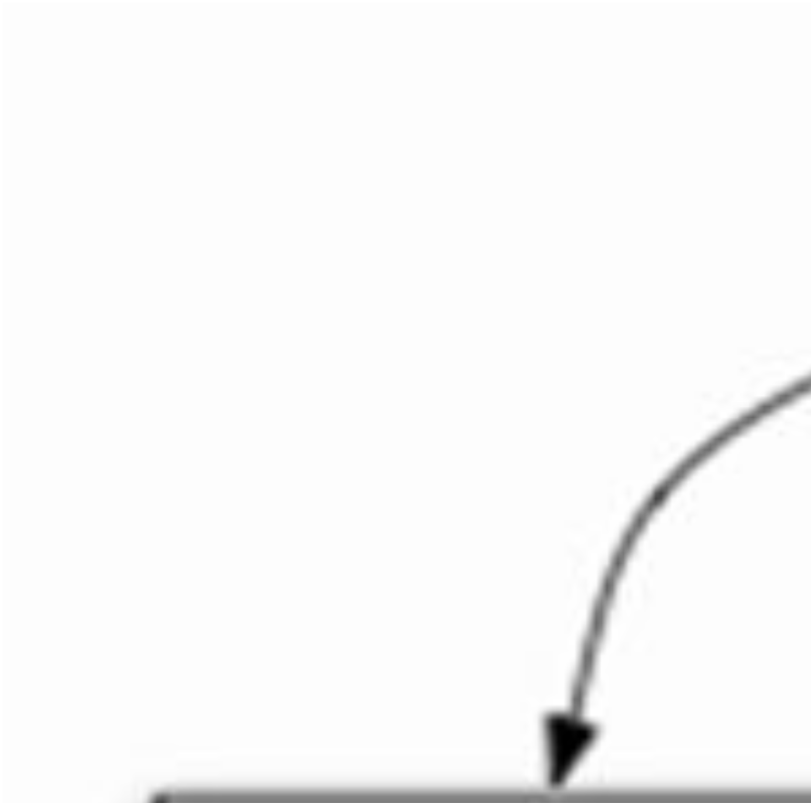
Refinement Consistency Example
Software Architecture: Foundations, Theory, and Practice; Richard N. Taylor, Nenad Medvidovic, and Eric M. Dashofy; © 2008 John Wiley & Sons, Inc. Reprinted with permission.

Slide 15
Architectural Analysis Goals – Compatibility
Compatibility is an external property of an architectural model
Ensures that the architectural model adheres to guidelines and constraints of
  a style
  a reference architecture
  an architectural standard

Slide 16
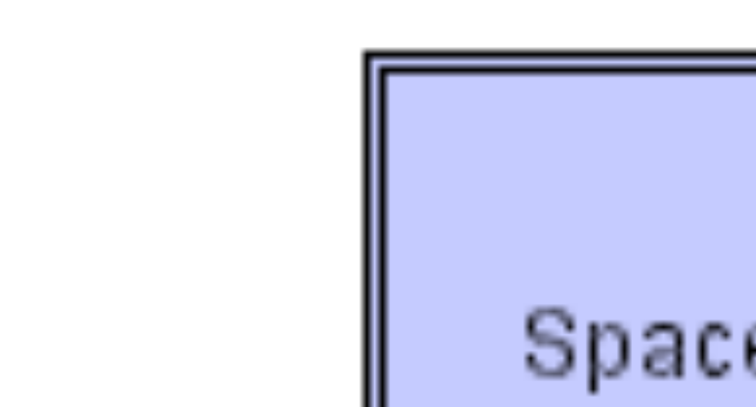
Architectural Compatibility Example – Lunar Lander
Software Architecture: Foundations, Theory, and Practice; Richard N. Taylor, Nenad Medvidovic, and Eric M. Dashofy; © 2008 John Wiley & Sons, Inc. Reprinted with permission.

Slide 17
Architectural Analysis Goals – Correctness
Correctness is an external property of an architectural model
Ensures that
  the architectural model fully realizes a system specification
  the system’s implementation fully realizes the architecture
Inclusion of OTS elements impacts correctness
  System may include structural elements, functionality, and non-functional properties that are not part of the architecture
  The notion of fulfillment is key to ensuring architectural correctness

Slide 18
Scope of Architectural Analysis
Component- and connector-level
Subsystem- and system-level
  Beware of the “honey-baked ham” syndrome
Data exchanged in a system or subsystem
  Data structure
  Data flow
  Properties of data exchange
Architectures at different abstraction levels
Comparison of two or more architectures
  Processing
  Data
  Interaction
  Configuration
  Non-functional properties

Slide 19
Data Exchange Example
Software Architecture: Foundations, Theory, and Practice; Richard N. Taylor, Nenad Medvidovic, and Eric M. Dashofy; © 2008 John Wiley & Sons, Inc. Reprinted with permission.

Slide 20
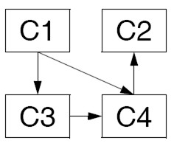
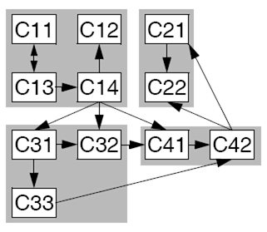
Architectures at Different Abstraction Levels
Software Architecture: Foundations, Theory, and Practice; Richard N. Taylor, Nenad Medvidovic, and Eric M. Dashofy; © 2008 John Wiley & Sons, Inc. Reprinted with permission.

Slide 21
Architectural Concern Being Analyzed
Structural characteristics
Behavioral characteristics
Interaction characteristics
Non-functional characteristics

Slide 22
Level of Formality
Informal models
Semi-formal models
Formal models

Slide 23
Type of Analysis
Static analysis
Dynamic analysis
Scenario-driven analysis
  Can be both static and dynamic

Slide 24
Level of Automation
Manual
Partially automated
Fully automated

Slide 25
Analysis Stakeholders
Architects
Developers
Managers
Customers
Vendors

Slide 26
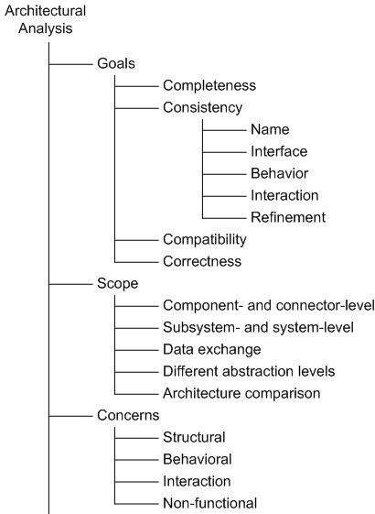
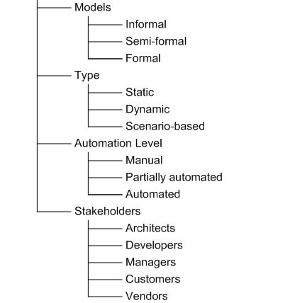
Architectural Analysis in a Nutshell
Software Architecture: Foundations, Theory, and Practice; Richard N. Taylor, Nenad Medvidovic, and Eric M. Dashofy; © 2008 John Wiley & Sons, Inc. Reprinted with permission.

